Slide 1

Tips for Getting Involved as a Contributor
By Justin Dearing
justin@mongodb.org
http://www.twitter.com/zippy1981
http://www.justaprogrammer.net

Slide 2
Who is Justin Dearing?
Programmer and accidental DBA at an ad firm called Wunderman
  Johnny Walker and Landrover are my Primary Clients
  .NET PHP Sql Server and MongoDB are the primary technologies I use

Slide 3
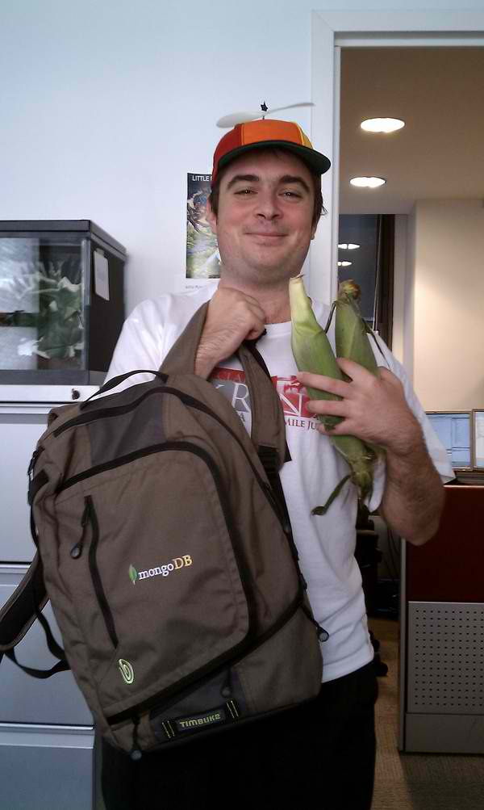
Who is Justin Dearing? (cont)
MongoDB Community Contributor
  Wiki Editor
  Core Server Contributor
  .NET Driver Contributor
  Mostly Windows related work

Slide 4
Why am I involved?
Selfishness: Fix problems I had with mongo.
Selfish Altruism: By giving back my changes, there is a larger pool to test, support and improve upon them.
Ego: bragging rights

Slide 5
Why should you get involved?
All of the above
Networking
Learning
Looks good on the resume
For MY benefit!!

Slide 6
Ways to get involved
Community Participation
Documentation
Driver Contributions
Core Server Contributions
Contributing to other projects

Slide 7
Community Participation and Documentation
IRC and google groups
Stackoverflow.com
Email meghan@10gen.com for a wiki acount
If you have not yet done so, read How To Ask Questions The Smart Way by Eric S Raymond

Slide 8
Driver and Core Server Contributions
File Bugs: http://jira.mongodb.org
Fork on github: https://github.com/mongodb/
Provide method to reproduce

Slide 9
Ideas for Contributing
Big Endian Support
Improving windows support
Porting to other Operating Systems
Logging

Slide 10
Ideas for Contributing (cont)
Triggers
Startup argument cleanup
Installers/packages

Slide 11
Contributing to other projects
Third party drivers
Mongo support for data access libraries
Mongo GUIs
Packet Sniffers
  See Wireshark Bug 5290
Anything you can think of

Slide 12
Ideas for third party contributions
log4{net|java|cpp|php} appenders
Tcpdump filter
Your favorite php framework

Slide 13
Thanks
10gen for writing mongodb and sponsoring my hotel
All of you for listening

Slide 14
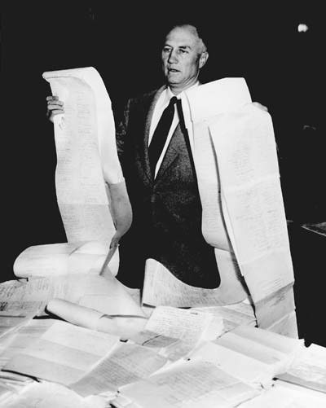
Filibuster

Slide 15
FIN
Everyone go to Dwight's Talk!!!
Also Afterparty at Carmine's!!!

